Slide 1
Advanced Embedded Systems
Room Temperature Controller
Team Hummer
Moataz Elbayaa
Ahmed Helmy
Manoj Luitel
Saikot Das Joy

Slide 2
Overview
Introduction
Concept
Smart Phone
Raspberry Pi
Step Motor Controller
Temperature sensor
Arduino wifi rev2
Step Motor

Slide 3
Technologies
MQTT & Smart Phone Application
Arduino Uni Wi-Fi REV 2
Temperature Sensor
Raspberry Pi

Slide 4
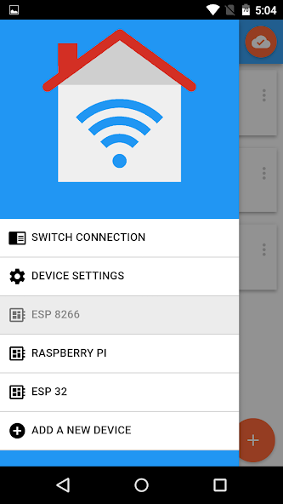
IoT MQTT Panel
An Android Application
It can act as a Publisher as well as a Receiver

Slide 5
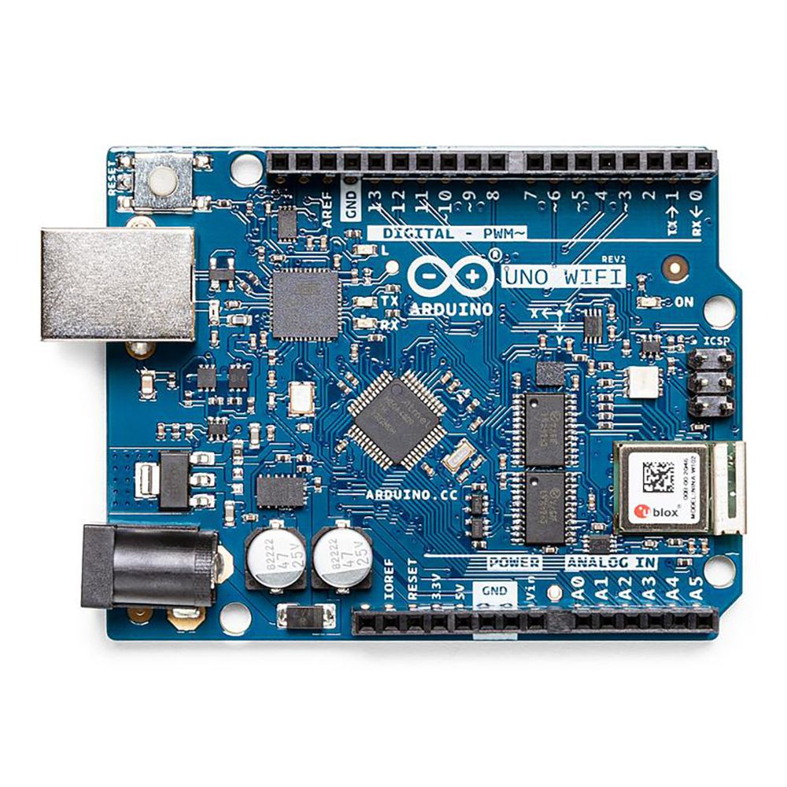
Arduino Uno Wi-Fi Rev2
Microchip ATmega4809 microcontroller
14 digital input/output pins
A self-contained SoC Wi-Fi module
with integrated TCP/IP protocol stack

Slide 6
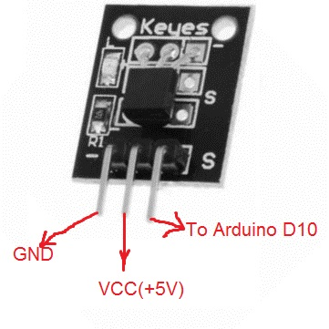
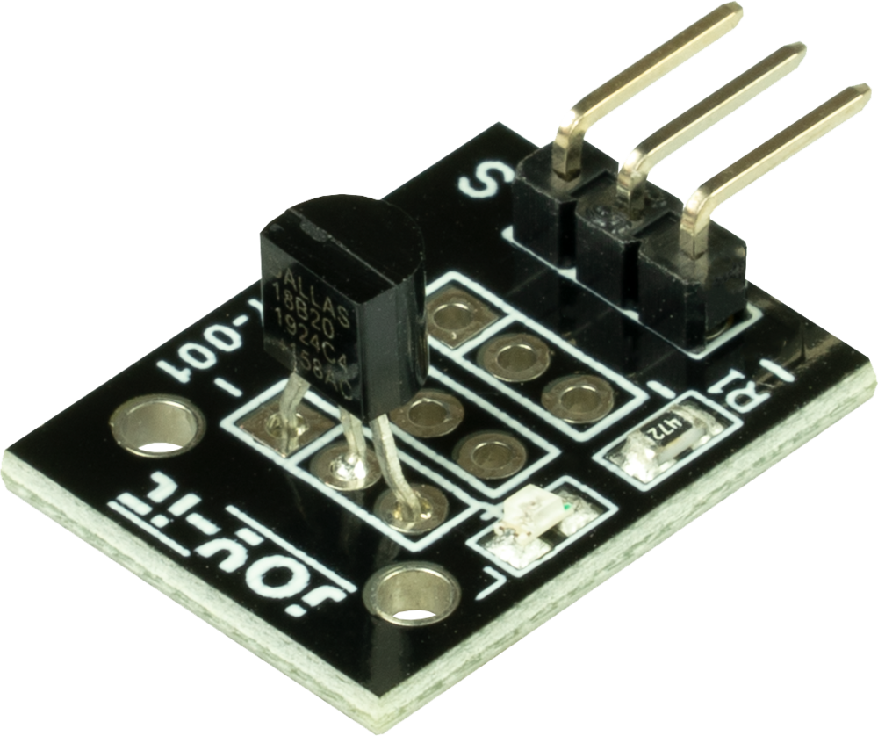
Temperature Sensor(KY-001)
9 to 12 bit Accuracy
Pin Assignment
-55 to +125 degree Cel.
1-wire communication

Slide 7
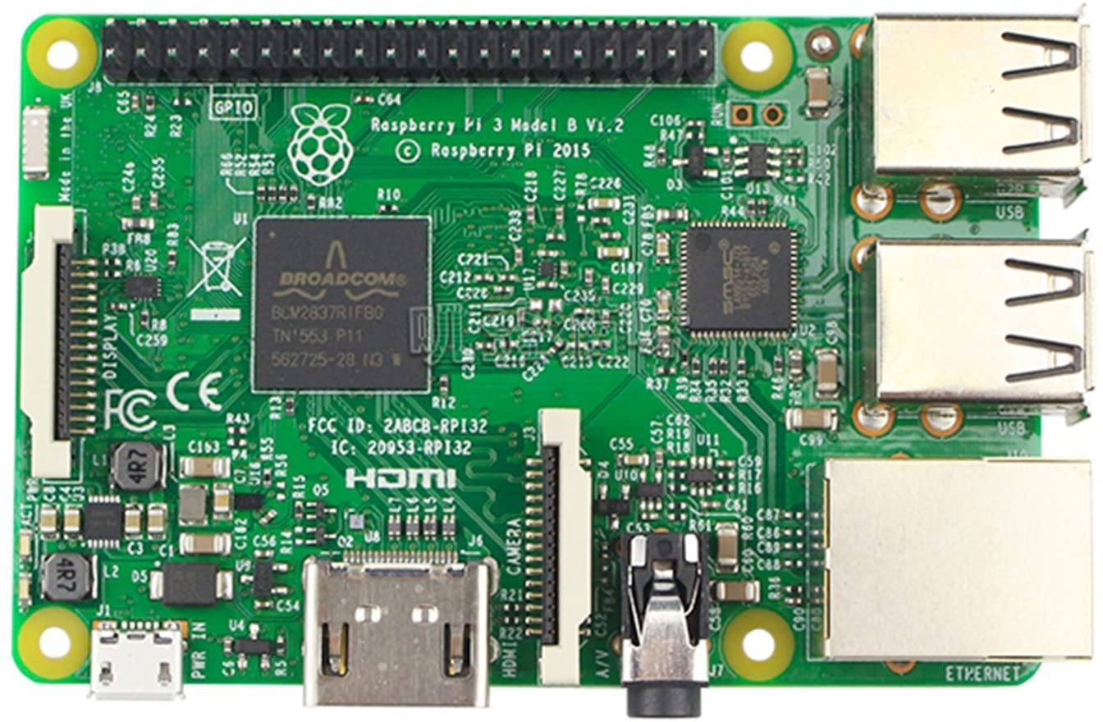
Raspberry Pi
Quad Core 1.2GHz Broadcom BCM2837 64bit CPU.
1GB RAM.
BCM43438 wireless LAN
100 Base Ethernet.
40-pin extended GPIO.
4 USB 2 ports.
4 Pole stereo output and composite video port.
Full size HDMI.

Slide 8
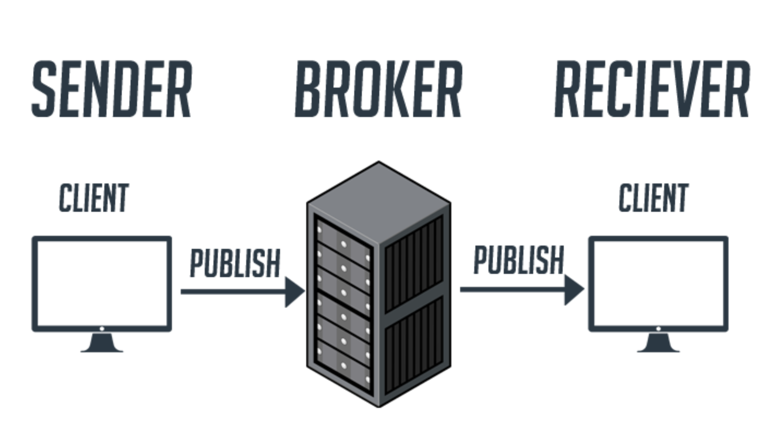
Wireless Communication with MQTT
Smartphone
Arduino Uno wifi rev2
MQTT on Raspberry Pi
https://mntolia.com/fundamentals-mqtt/

Slide 9
How MQTT broker works
Device can publish data to a topic in the broker
Another device can subscribe to that topic and read the data.
One device can be a publisher and a subscriber together
On our project, Smartphone publishes data to the topic named “desired_temperature” . Wirelessly Connected Arduino with the Raspberry Pi subscribes to this topic and reads the data published on this topic.

Slide 10
Raspberry Pi set up
Install Raspberry Pi operating system on memory card and insert that memory card on Raspberry Pi .
Connect mouse, keyboard,monitor with raspberry Pi
Connect Raspberry Pi to the wifi on which Arduino and Smartphone is also connected.
Install mosquito MQTT broker on it. Set up the config file. Also enable mqtt broker.
Get the IP address of Raspberry Pi.

Slide 11
Arduino Code
Room temperature measurement.
Getting the desired temperature.
Checking desired temperature comparing to room temperature.
After achieving desired temperature.
Keeping room temperature at desired temperature.
Receiving and achieving new desired temperature.

Slide 12
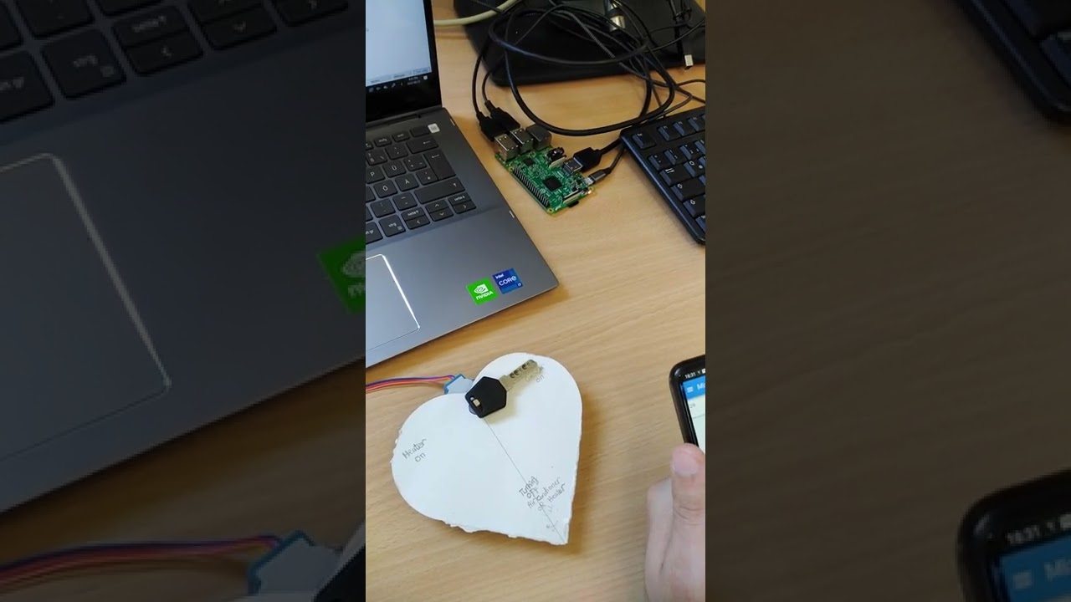
Implementation and Hardware Results

